Slide 1

SECURITY TRAINING FOR DOOR SUPERVISORS

Slide 2

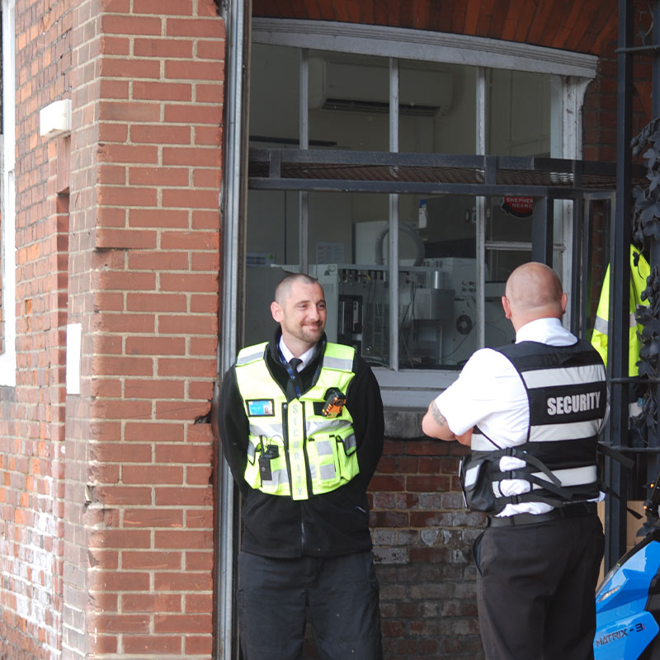
Background
Who is a door supervisor?
Licensed security operative who guards licensed premises such as pubs, bars and nightclubs (Rickett and Roman, 2013; Wilson, 2015).
Door supervisors are the largest licensed private security sector in the United Kingdom, overseen by the SIA (Kostara, 2021).

Slide 3


The Training
Training for door supervisors.
Two groups of six trainees each.
Delivered by qualified door supervisor trainers.
A six-day training (16th – 21st January)
Carried out at Dankel security office.
Security operatives working under the SIA (security industry Authority) and prospective security operatives.
Purpose of training
Reports of substandard professionalism, aggression, and illegal activities among door supervisors (Kostara, 2021)
To equip door supervisors with the necessary skills to carry out their duties effectively

Slide 4





Define the Purpose and Goals
Gather Information
Analyze the Data
Develop Training Objectives
Design the Training Program
Implement and Evaluate the Training
Training needs assessment steps (Brown, 2002; Denby, 2010)

Slide 5

TRAINING EVALUATION
Strength
Legal Compliance
Weakness
Limited Scope
Crime Prevention
Communication Skills
Conflict Management
Physical Intervention
Time-Consuming
Limited Evaluation
High Turnover

Slide 6

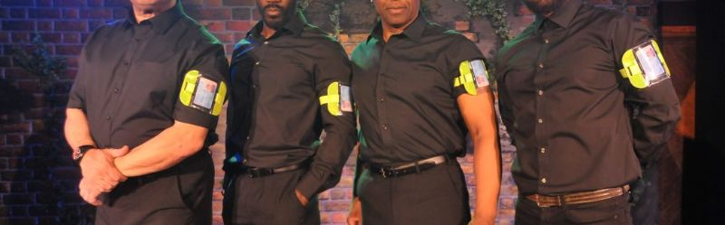
Recommendation
Quality Assurance
Comprehensive Curriculum
Experienced Instructors
Practical Training
Continuing Professional Development
Evaluation and Feedback
Accessible and Flexible

Slide 7
References
Brown, J., 2002. Training needs assessment: A must for developing an effective training program. Public personnel management, 31(4), pp.569-578.
Denby, S., 2010. The importance of training needs analysis. Industrial and commercial training, 42(3), pp.147-150.
Kostara, F., 2021. The regulation of private security and its challenges in contemporary society: assessing the Security Industry Authority’s regulatory approach to door supervisors in the UK (Doctoral dissertation, Cardiff University).
Rickett, B. and Roman, A., 2013. ‘Heroes and Matriarchs’: Working‐Class Femininities, Violence and Door Supervision Work. Gender, Work & Organization, 20(6), pp.664-677.
Wilson, A., 2015. Door Supervision: Location, Capability, Collaboration (Doctoral dissertation, University of Sheffield).

